Slide 1
Data Preparation
CS3300 Data Science
RJ Nowling

Slide 2
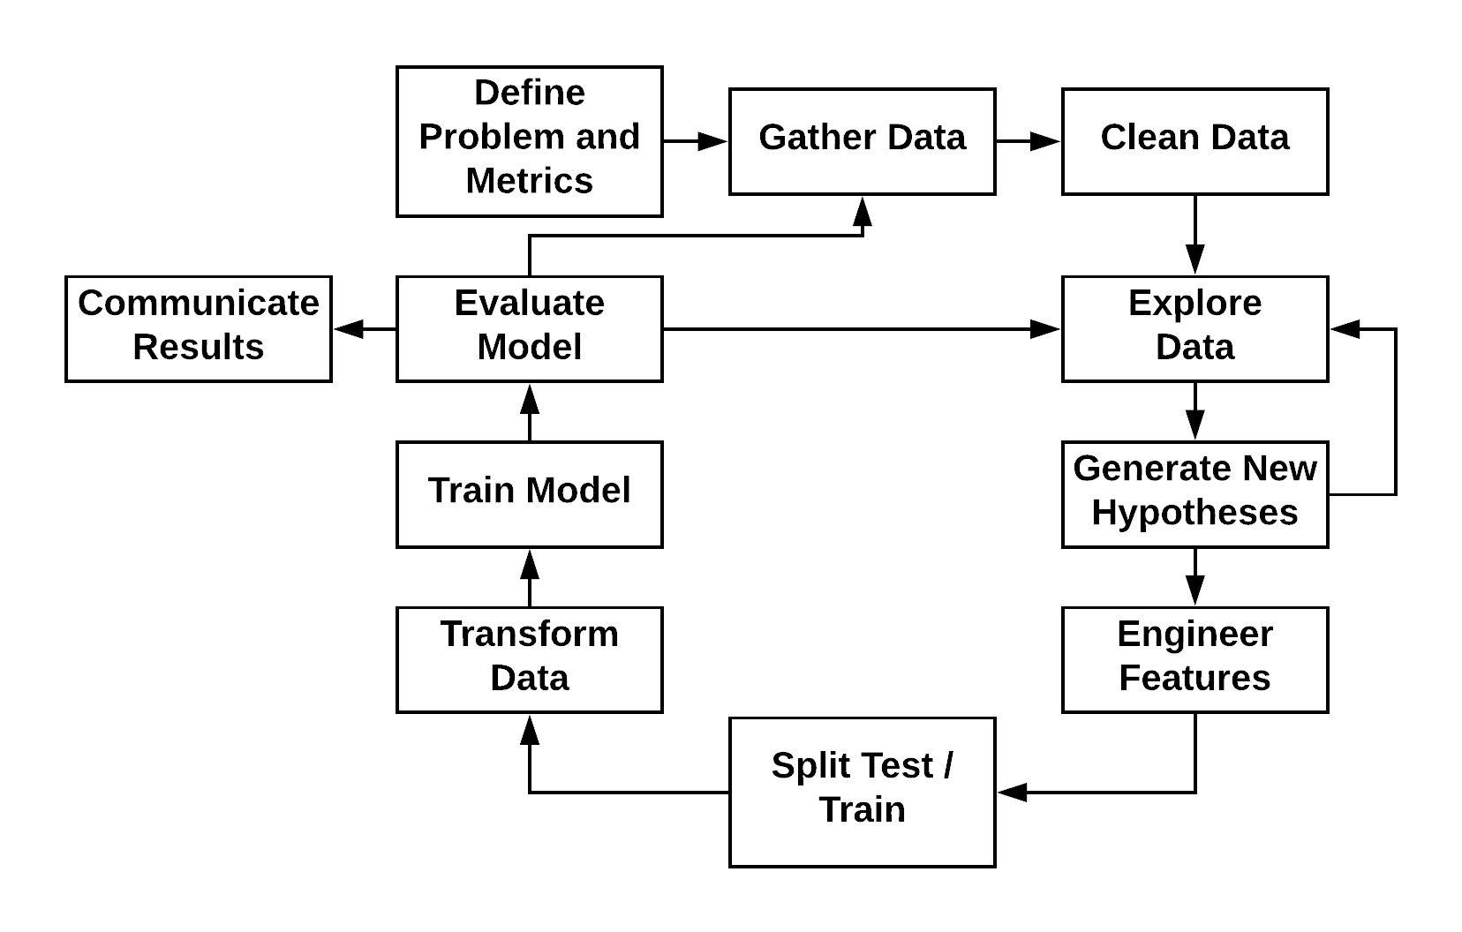
Machine Learning Process

Slide 3
Experimental Setup & Model Evaluation
In most real-world use cases, we want to:
Train a model on data we have
to make predictions on data we haven't seen yet
Examples:
Predict what ads a user will click on given their past history

Slide 4
Experimental Setup & Model Evaluation
We want our experiments to tell us how a model will perform when applied to unseen data
We design our experiment to match the real-world use case
We divide data (records) into:
Training set – used for training the model
Validation set – used for optimizing model hyper-parameters (most commonly used with deep learning)
Testing set – used for evaluating the model's predictions
Since the testing set data is not used at all in training, it becomes an accurate way to evaluate a model's performance on unseen data

Slide 5
Experimental Setup
Our goal with predictive models is to predict the value of an outcome variable on unseen data
To properly evaluate our models, we need to simulate this
So, we divide data into training and testing sets
We train on the training set
And evaluate the model on the testing set
For right now, we can simply assign 75% of records randomly to the training set and the remaining to the testing set

Slide 6
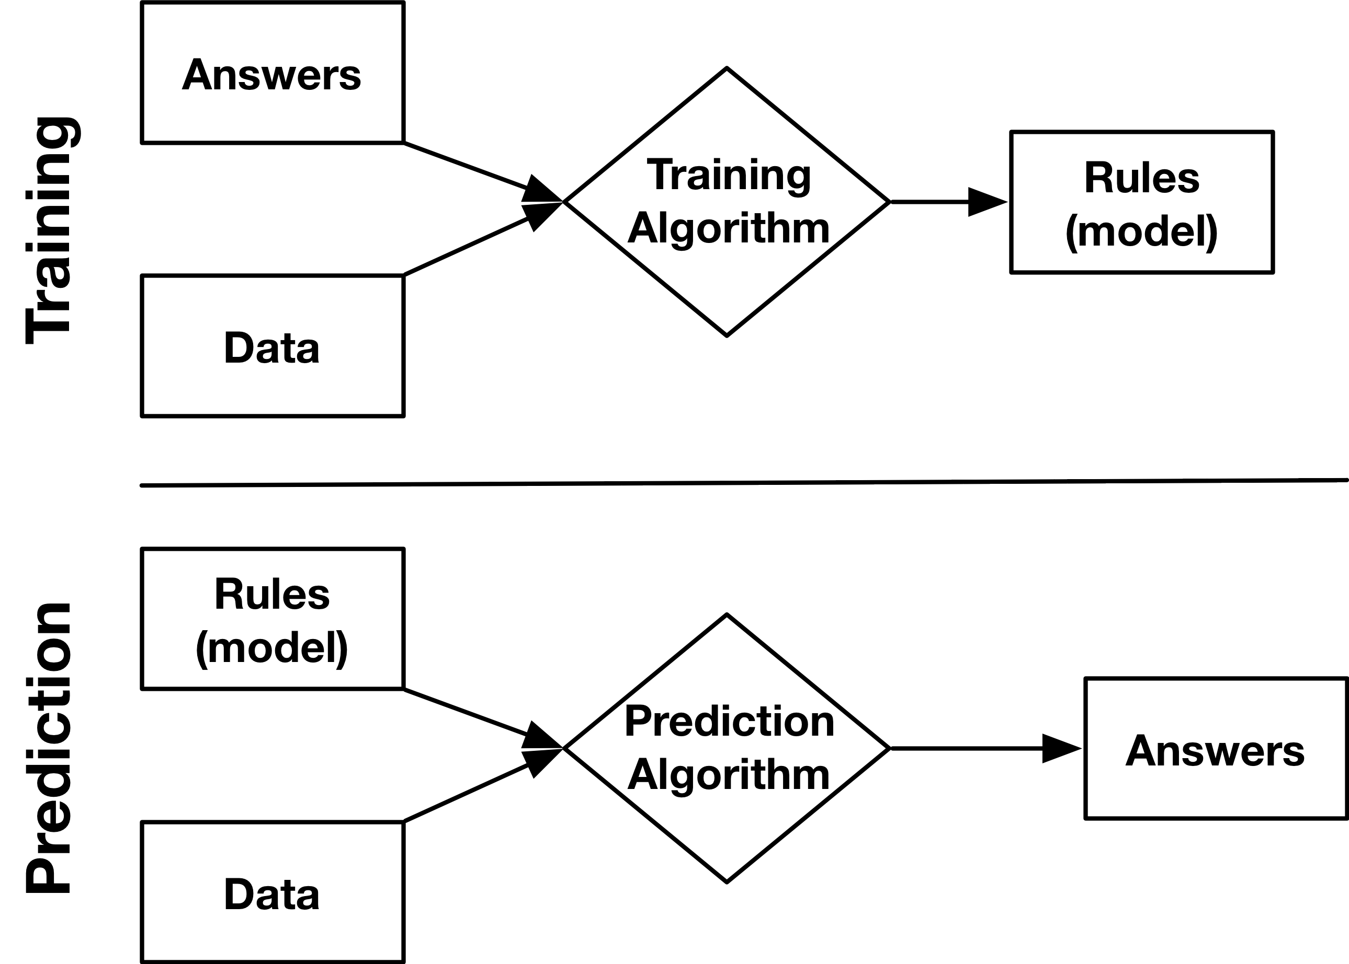
Machine Learning

Slide 7
Training Problems
Overfitting
Leaking Labels

Slide 8
Train-Test Split
Random Sampling without Replacement
Simplest approach
Appropriate for regression problems that are not time dependent
Procedure
For each record, flip a coin to decide if the record goes into the training or testing set
Frequently, 75% of records are used for training and 25% for testing

Slide 9
Train-Test Split
Stratification Followed by Random Sampling without Replacement
Ensures that the class ratios for the training and testing sets match the original data set
Appropriate for classification problems
Procedure
Samples are divided by their class labels
Each class is divided into a training and testing set using random sampling without replacement
All training sets are merged to produce a single training set
All testing sets are merged to produce a single testing set

Slide 10
Train-Test Split
Partition by Time
Used for data that depends on time (e.g., weather data)
Procedure
Choose a cutoff time: either a single point in time OR for each record individually
Training set: all records before the cutoff
Testing set: all records after the cutoff

Slide 11
Train-Test Split
Records may not be independent
A single patient will have records from multiple points in time (e.g., one for each doctor visit)
If a patient's records end up in both sits, you will not be able to detect overfitting
Procedure
Organize the records into groups (all records belong to same patient)
Randomly assign entire groups to training or testing set (e.g., sampling with replacement, stratification)

Slide 12
Train-Test Split
Complex situations may arise
Example: Predict whether a patient will be diagnosed with Alzheimer's in the future based on (other) past diagnoses
Time dependent: need to use records BEFORE Alzheimer's diagnoses for training
Class dependent: stratify by Alzheimer's vs not
Patient dependent: need to keep records grouped by patient

Slide 13
Train-Test Split
Solution: Predict whether a patient will be diagnosed with Alzheimer's in the future based on (other) past diagnoses
Stratify patients by outcome (Alzheimer's vs not)
For Alzheimer's positive patients, divide each patients' records into before and after diagnosis; discard records from AFTER diagnosis
Within each class, assign patients using random sampling with replacement
Merge training and testing sets

